Slide 1
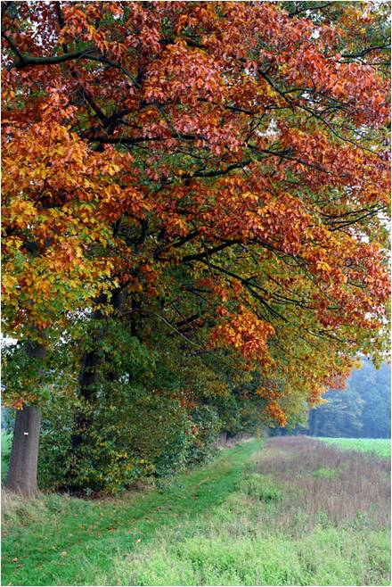


HICKORY HILLS
Phase IV & V
Where town and country meet
Lots priced from $16,000 -$35,000
Estate Size Lots
Outbuildings allowed up to 1200 sq. ft.
Ask Randy FREE Builder Consultation
Fastest Growing Subdivision in town
New Model Homes Available
Energy Efficient Builder available

Slide 2
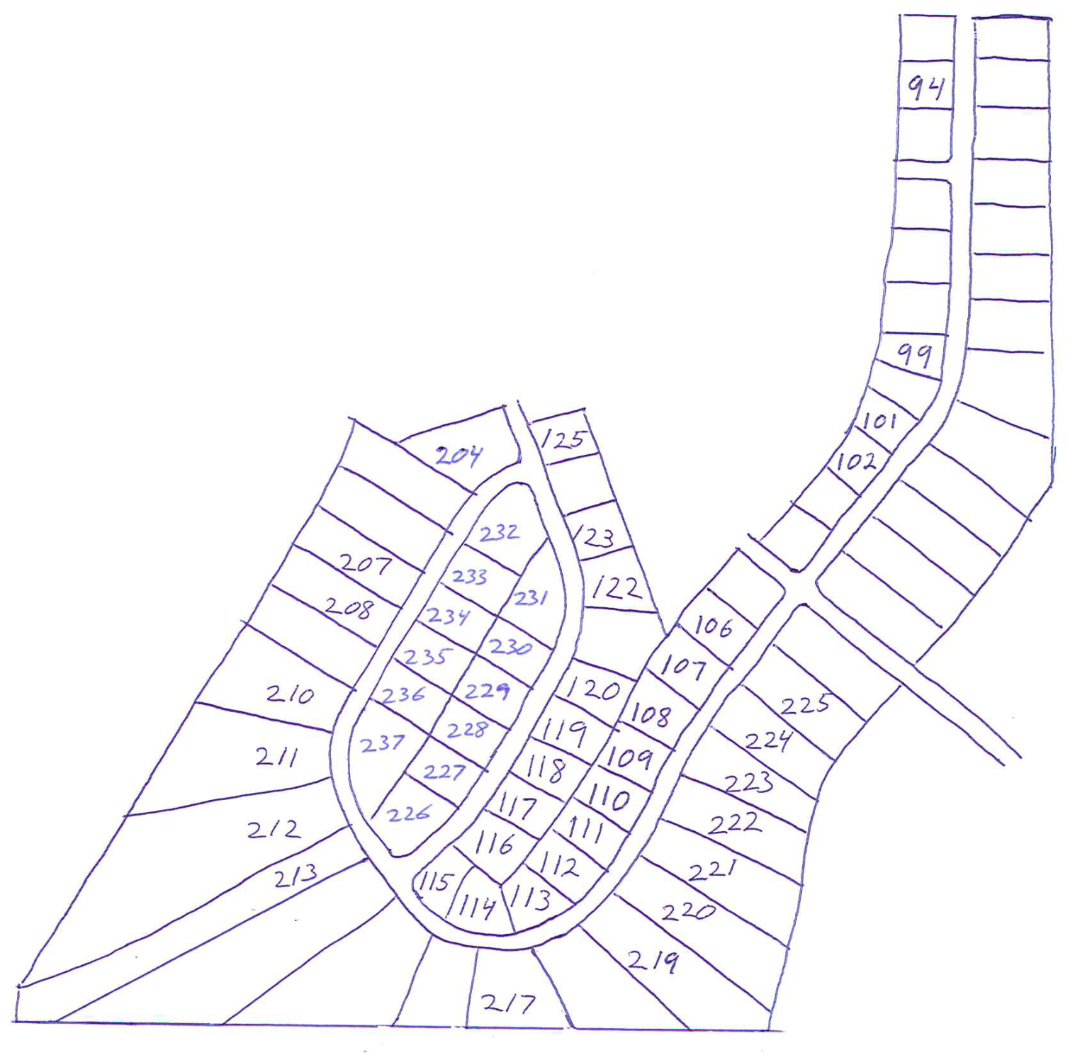



HICKORY HILLS, phase IV & v where town and country meet
Contact
Directions
50 Hwy to 7 Hwy, South to Pleasant Hill, Continue South to Country Club Drive, West 1.2miles then (Left) on Mulberry .8 mile to Buckeye Lane. Left on Buckeye Ln.
Randy Gish
816.365.HOME (4663)
Office: 816.540.5555
RandyGish@reeceandnichols.com
RandyGish.reeceandnichols.com
Experienced Home Builder
Estate Size Lots
Model Homes Available
Free Build Job Consultation
HBA Member
Sold
Sold
MODEL
MODEL
Sold
Sold
Sold
Sold
Sold
Sold
216
Lots are Selling Fast, Reserve Yours Today!

